Slide 1
Queues

Slide 2

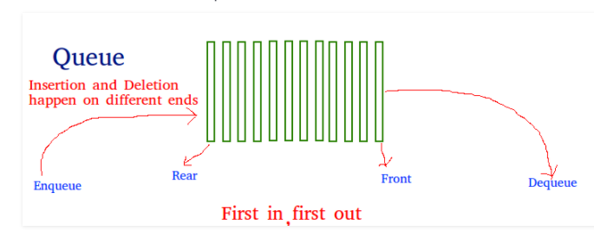

Slide 3
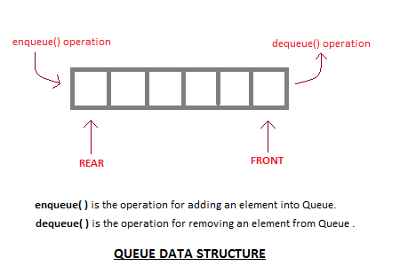
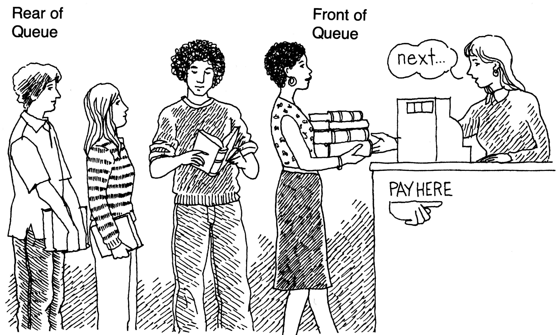
What is a queue?
It is an ordered group of homogeneous items of elements.
Queues have two ends:
  Elements are added at one end.
  Elements are removed from the other end.
The element added first is also removed first (FIFO: First In, First Out).

Slide 4
Applications of Queues
Queues are widely used as waiting lists for a single shared resource like printer, disk, CPU.
Queues are used in asynchronous transfer of data (where data is not being transferred at the same rate between two processes) for eg. pipes, file IO, sockets.
Queues are used as buffers in most of the applications like MP3 media player, CD player, etc.
Queue are used to maintain the play list in media players in order to add and remove the songs from the play-list.
Queues are used in operating systems for handling interrupts.

Slide 5
Queue Specification
Definitions: MAX_ITEMS: Max number of items that might be on the queue
  ItemType: Data type of the items on the queue
Operations
  MakeEmpty
  Boolean IsEmpty
  Boolean IsFull
  Enqueue (ItemType newItem)
  Dequeue (ItemType& item)

Slide 6
Enqueue (ItemType newItem)
Function: Adds newItem to the rear of the queue.
Preconditions: Queue has been initialized and is not full.
Postconditions: newItem is at rear of queue.

Slide 7
Dequeue (ItemType& item)
Function: Removes front item from queue and returns it in item.
Preconditions: Queue has been initialized and is not empty.
Postconditions: Front element has been removed from queue and item is a copy of removed element.

Slide 8
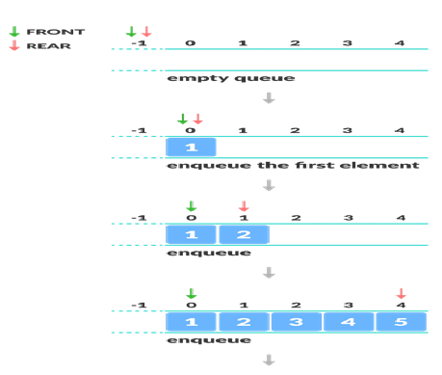
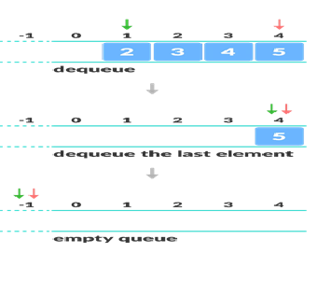

Slide 9
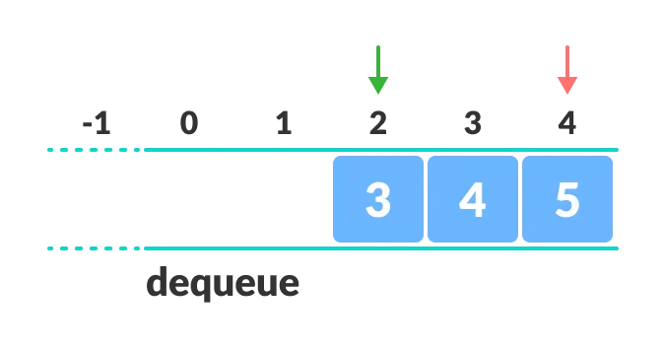
Limitations of Queue
As you can see in the image below, after a bit of enqueuing and dequeuing, the size of the queue has been reduced.

Slide 10
Implementation issues
Implement the queue as a circular structure.
How do we know if a queue is full or empty?
Initialization of front and rear.
Testing for a full or empty queue.

Slide 11
Queue overflow
The condition resulting from trying to add an element onto a full queue.
if(!q.IsFull())
q.Enqueue(item);

Slide 12
Queue underflow
The condition resulting from trying to remove an element from an empty queue.
if(!q.IsEmpty())
q.Dequeue(item);

Slide 13
bool isfull() {
if(rear == MAXSIZE - 1)
return true;
else
return false;
}
bool isempty() {
if(front < 0 || front > rear)
return true;
else
return false;
}

Slide 14
Queue Operations using Array
Queue data structure using array can be implemented as follows...
Before we implement actual operations, first follow the below steps to create an empty queue.
Step 1 - Include all the header files which are used in the program and define a constant 'SIZE' with specific value.
Step 2 - Declare all the user defined functions which are used in queue implementation.
Step 3 - Create a one dimensional array with above defined SIZE (int queue[SIZE])
Step 4 - Define two integer variables 'front' and 'rear' and initialize both with '-1'. (int front = -1, rear = -1)
Step 5 - Then implement main method by displaying menu of operations list and make suitable function calls to perform operation selected by the user on queue.

Slide 15
enQueue(value) - Inserting value into the queue
In a queue data structure, enQueue() is a function used to insert a new element into the queue.
In a queue, the new element is always inserted at rear position.
The enQueue() function takes one integer value as a parameter and inserts that value into the queue.
We can use the following steps to insert an element into the queue...
Step 1 - Check whether queue is FULL. (rear == SIZE-1)
Step 2 - If it is FULL, then display "Queue is FULL!!! Insertion is not possible!!!" and terminate the function.
Step 3 - If it is NOT FULL, then increment rear value by one (rear++) and set queue[rear] = value.

Slide 16
deQueue() - Deleting a value from the Queue
In a queue data structure, deQueue() is a function used to delete an element from the queue.
In a queue, the element is always deleted from front position.
The deQueue() function does not take any value as parameter.
We can use the following steps to delete an element from the queue...
Step 1 - Check whether queue is EMPTY. (front == rear)
Step 2 - If it is EMPTY, then display "Queue is EMPTY!!! Deletion is not possible!!!" and terminate the function.
Step 3 –If it is NOT EMPTY, then increment the front value by one (front ++).
Then display queue[front] as deleted element.
Then check whether both front and rear are equal (front == rear), if it TRUE, then set both front and rear to '-1' (front = rear = -1).

Slide 17
display() - Displays the elements of a Queue
We can use the following steps to display the elements of a queue...
Step 1 - Check whether queue is EMPTY. (front == rear)
Step 2 - If it is EMPTY, then display "Queue is EMPTY!!!" and terminate the function.
Step 3 - If it is NOT EMPTY, then define an integer variable 'i' and set 'i = front+1'.
Step 4 - Display 'queue[i]' value and increment 'i' value by one (i++). Repeat the same until 'i' value reaches to rear (i <= rear)

Slide 18
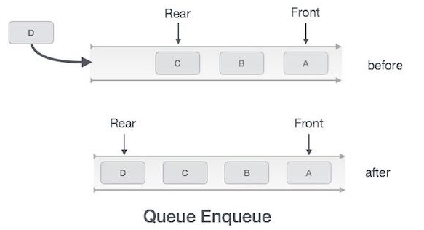
Enqueue Operation :
Queues maintain two data pointers, front and rear. Therefore, its operations are comparatively difficult to implement than that of stacks.
The following steps should be taken to enqueue (insert) data into a queue −
Step 1 − Check if the queue is full.
Step 2 − If the queue is full, produce overflow error and exit.
Step 3 − If the queue is not full, increment rear pointer to point the next empty space.
Step 4 − Add data element to the queue location, where the rear is pointing.
Step 5 − return success.
int enqueue(int data)
if(isfull())
“Queue Overflow”
return 0;
else
rear = rear + 1;
queue[rear] = data;
endif
return 1;
end procedure

Slide 19
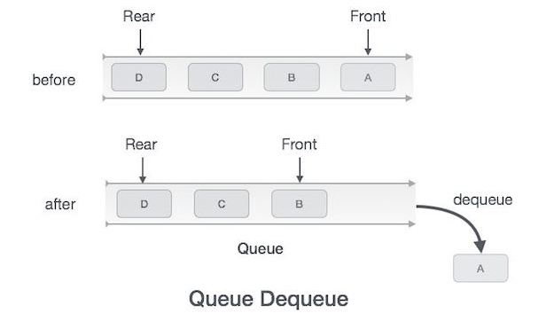
Dequeue Operation:
Accessing data from the queue is a process of two tasks − access the data where front is pointing and remove the data after access. The following steps are taken to perform dequeue operation −
Step 1 − Check if the queue is empty.
Step 2 − If the queue is empty, produce underflow error and exit.
Step 3 − If the queue is not empty, access the data where front is pointing.
Step 4 − Increment front pointer to point to the next available data element.
Step 5 − Return success.
int dequeue() {
if(isempty())
“Queue Underflow”
return 0;
else
int data = queue[front];
front = front + 1;
endif
return data; }

Slide 20
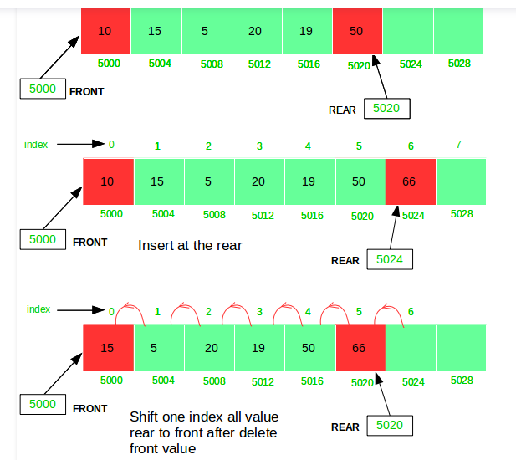

Slide 21
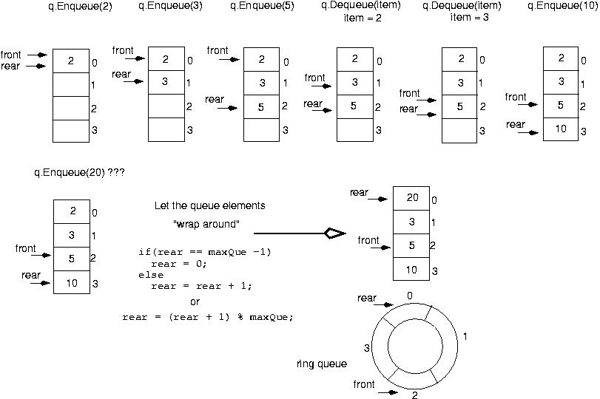

Slide 22
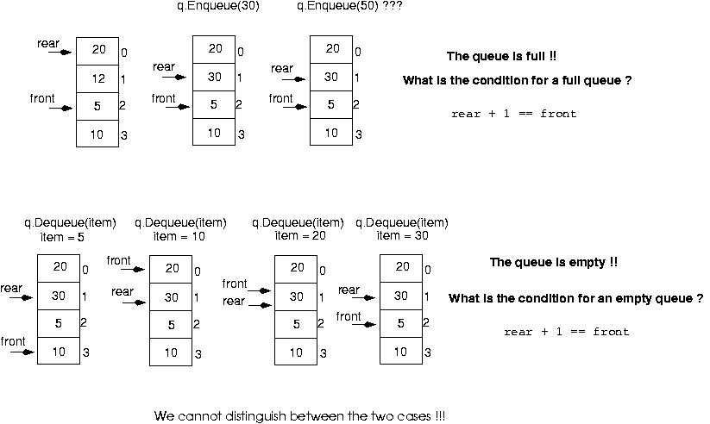

Slide 23
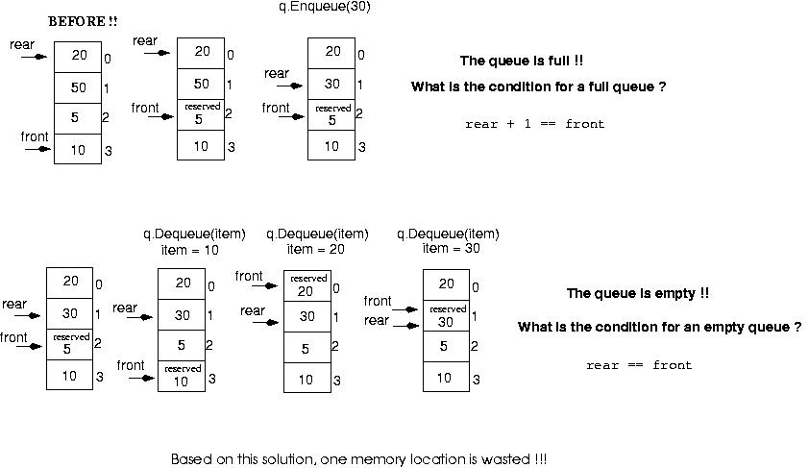

Slide 24
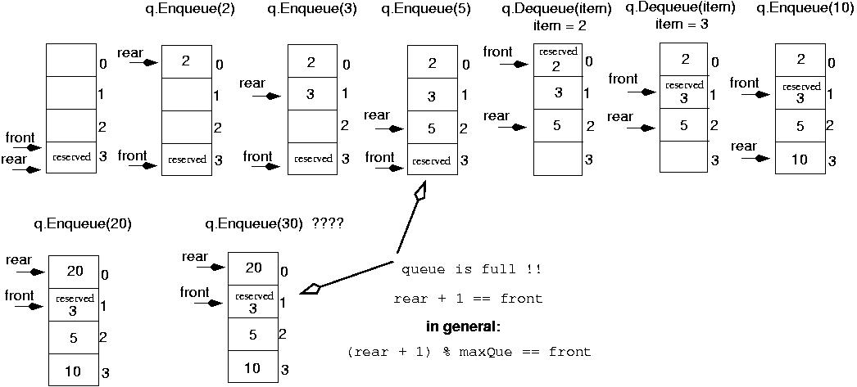
Initialize front and rear

Slide 25
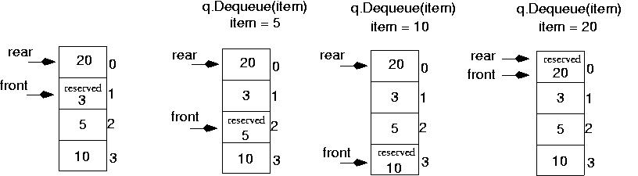
Queue is empty now!!
rear == front

Slide 26
/* * C Program to Implement a Queue using an Array */
#include <stdio.h>
#define MAX 50
void insert();
void delete();
void display();
int queue_array[MAX];
int rear = - 1;
int front = - 1;
main()
{ int choice;
while (1)
{ printf("1.Insert element to queue \n");
printf("2.Delete element from queue \n");
printf("3.Display all elements of queue \n");
printf("4.Quit \n");
printf("Enter your choice : ");
scanf("%d", &choice);
switch (choice)
{
case 1:
insert(); break;
case 2:
delete(); break;
case 3:
display(); break;
case 4:
exit(1);
default:
printf("Wrong choice \n");
} /* End of switch */
} /* End of while */
} /* End of main() */

Slide 27
void insert()
{ int add_item;
if (rear == MAX - 1)
printf("Queue Overflow \n");
else
{ if (front == - 1) /*If queue is initially empty */
front = 0;
printf("Inset the element in queue : ");
scanf("%d", &add_item);
rear = rear + 1;
queue_array[rear] = add_item;
}
} /* End of insert() */

Slide 28
void delete()
{ if (front == - 1 || front > rear)
{ printf("Queue Underflow \n");
return ;
}
else
{ printf("Element deleted from queue is : %d\n", queue_array[front]);
front = front + 1;
}
} /* End of delete() */

Slide 29
void display()
{ int i;
if (front == - 1)
printf("Queue is empty \n");
else
{ printf("Queue is : \n");
for (i = front; i <= rear; i++)
printf("%d ", queue_array[i]);
printf("\n");
}
} /* End of display() */

Slide 30
Execution Test Case

Slide 31
1.Insert element to queue
2.Delete element from queue
3.Display all elements of queue
4.Quit
Enter your choice : 1
Inset the element in queue : 10
1.Insert element to queue
2.Delete element from queue
3.Display all elements of queue
4.Quit
Enter your choice : 1
Inset the element in queue : 15
1.Insert element to queue
2.Delete element from queue
3.Display all elements of queue
4.Quit
Enter your choice : 1
Inset the element in queue : 20
1.Insert element to queue
2.Delete element from queue
3.Display all elements of queue
4.Quit
Enter your choice : 1
Inset the element in queue : 30
1.Insert element to queue
2.Delete element from queue
3.Display all elements of queue
4.Quit
Enter your choice : 2
Element deleted from queue is : 10
1.Insert element to queue
2.Delete element from queue
3.Display all elements of queue
4.Quit
Enter your choice : 3
Queue is :
15 20 30
1.Insert element to queue
2.Delete element from queue
3.Display all elements of queue
4.Quit
Enter your choice : 4

Slide 32
Example: recognizing palindromes
A palindrome is a string that reads the same forward and backward.
Able was I ere I saw Elba
We will read the line of text into both a stack and a queue.
Compare the contents of the stack and the queue character-by-character to see if they would produce the same string of characters.

Slide 33
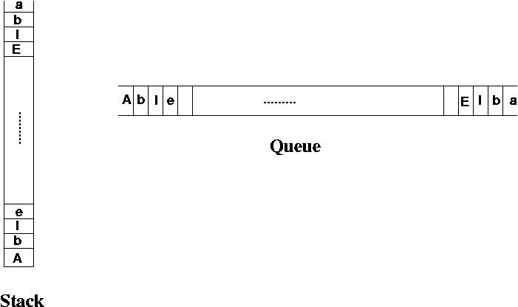
Digital Assignment 1a: recognizing palindromes

Slide 34
Case Study: Simulation
Queuing System: consists of servers and queues of objects to be served.
Simulation: a program that determines how long items must wait in line before being served.

Slide 35
Case Study: Simulation (cont.)
Inputs to the simulation:
(1) the length of the simulation
(2) the average transaction time
(3) the number of servers
(4) the average time between job arrivals

